Slide 1
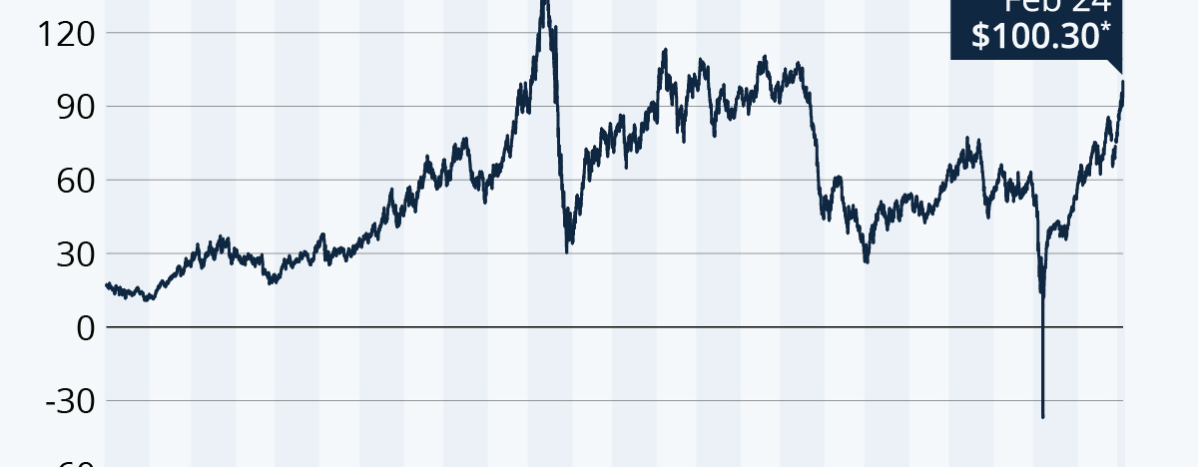
Oil Price Prediction
Explore machine learning models to forecast fluctuations in global crude oil prices and inform business decisions.

Slide 2


Team Members
Mentor’s Name: Stephy
Project Trainer: Sravani
Bhagaban Desudu
Rohit R
Varun Gowda s
Divya Santosh Virkud
Anurag Khilare
Alekya Rani Seeapu

Slide 3

Introduction
This slide introduces the Oil Price Prediction project, which aims to forecast crude oil prices using machine learning techniques. The project's goal is to develop accurate predictive models that can be deployed in a Streamlit application, providing users with dynamic forecasts and insights.

Slide 4


Objective
Importance of crude oil price forecasting
Project objective
Economic volatility, business impact, and the need for accurate predictions
Develop machine learning models to forecast crude oil prices and deploy them in a Streamlit application
This project aims to address the critical need for accurate crude oil price forecasting by leveraging machine learning models and deploying them in an interactive Streamlit application.

Slide 5
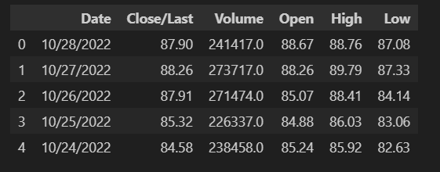
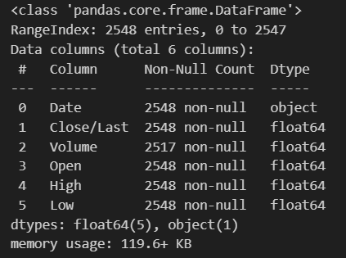
Dataset Overview
Dataset Overview
Dataset Features
Dataset Size and Info
Historical crude oil prices
'Date', 'Close/Last', 'Volume', 'Open', 'High', 'Low'
Over 2548 entries

Slide 6
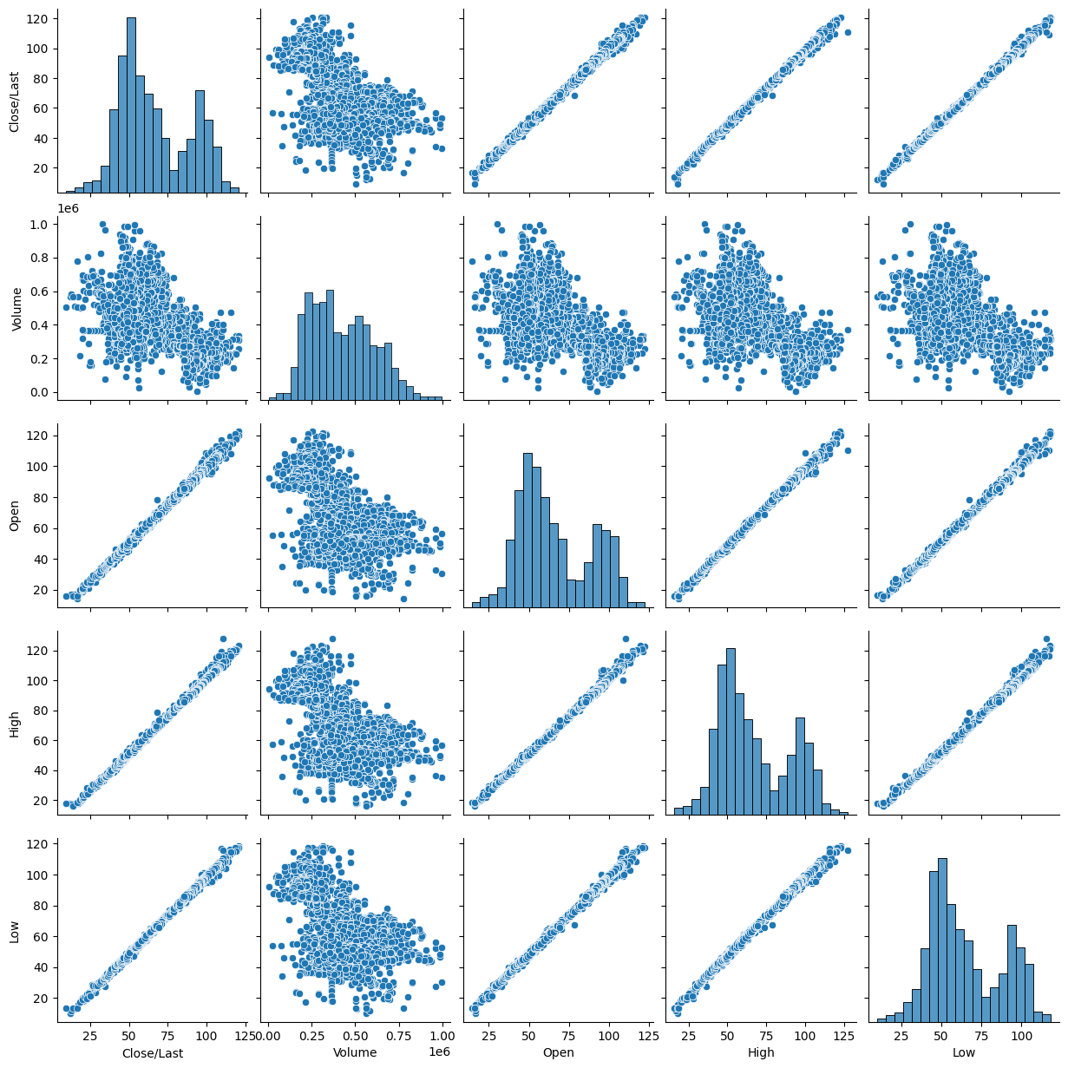
Exploratory Data Analysis (EDA)
The Exploratory Data Analysis (EDA) for the Oil Price Prediction project has revealed several key insights. The analysis of the historical crude oil price data shows clear trends and seasonal patterns, with significant volatility and outliers detected. A line chart visualizing the oil price over time provides a clear representation of these insights, highlighting the fluctuations and changes in the market.

Slide 7
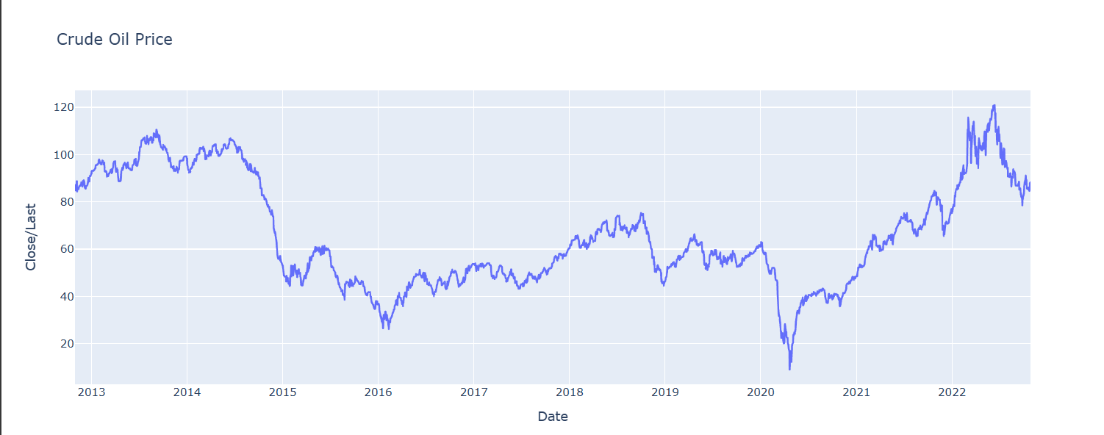
Crude Oil Price

Slide 8
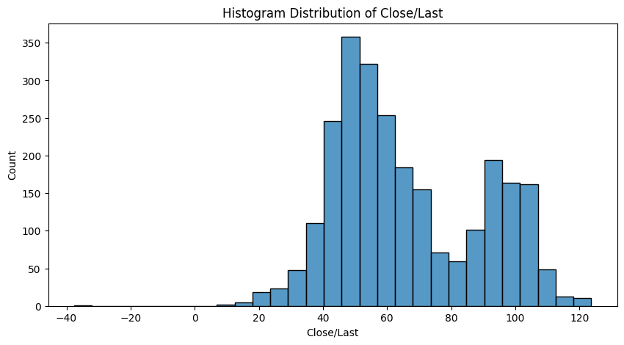
Histogram Distribution of Close/Last

Slide 9
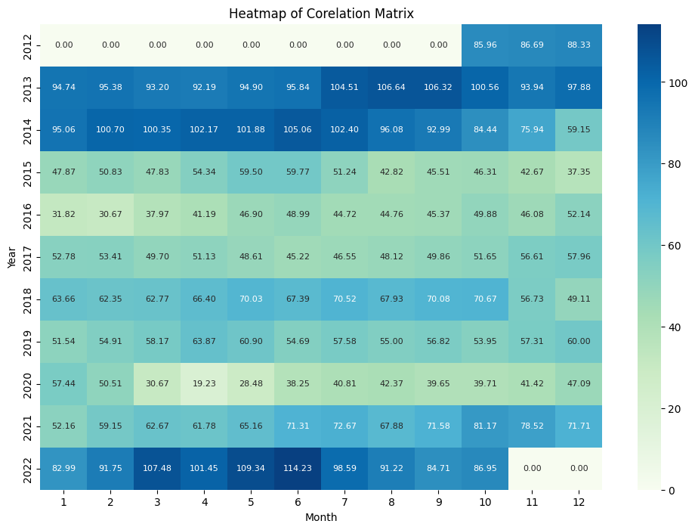
Heatmap of Corelation Matrix
We transformed daily oil price data into a Year-Month matrix of average closing prices.
This highlights monthly and seasonal patterns,
making it easier to detect long-term trends and prepare the dataset for forecasting models
such as ARIMA and Exponential Smoothing

Slide 10
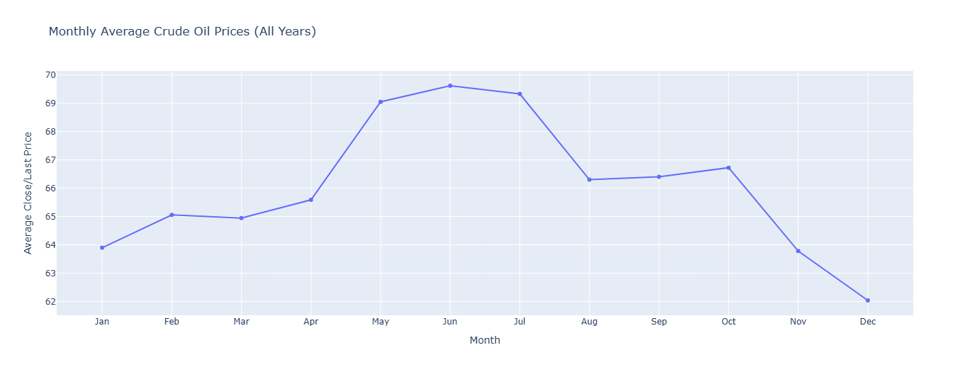
Monthly Average Crude Oil Prices (All Years)

Slide 11
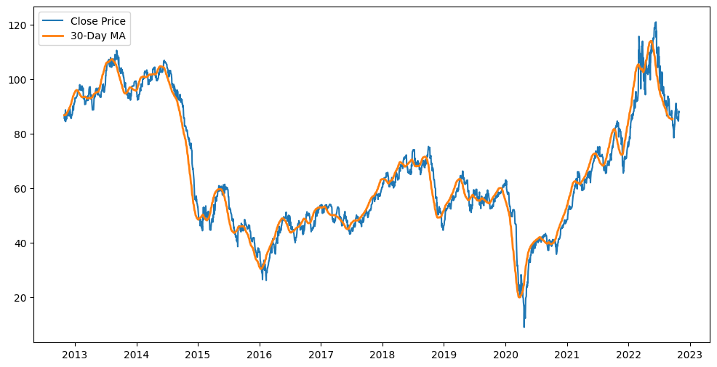
Rolling mean/median (7-day, 30-day)

Slide 12
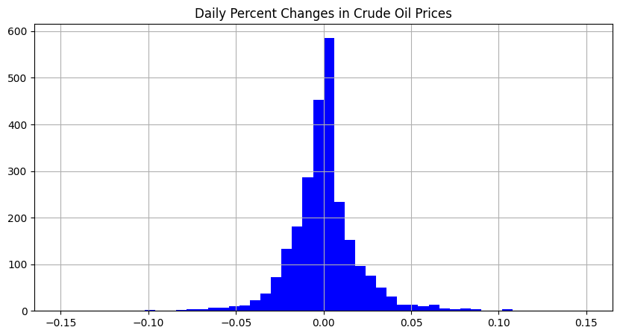

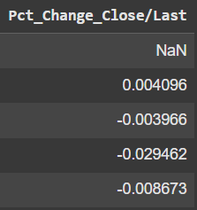
Daily Percentage Changes in Close / Last

Slide 13
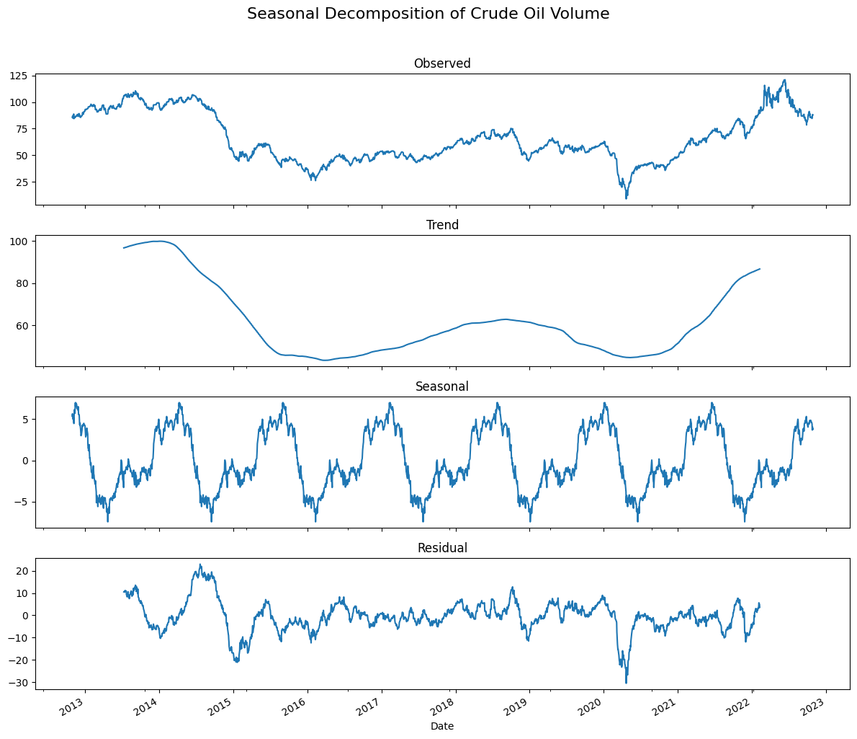
Seasonal Decomposition of Crude Oil Volume

Slide 14




Data Preprocessing
Handling Missing Values
Date Column Conversion
Train-Test Split
Outlier Detection and Handling
The dataset initially had 31 missing values in the 'Volume' column. These missing values were interpolated using the 'linear' method, resulting in a complete dataset with no missing values.
The 'Date' column was originally in string format and was converted to datetime format using `pd.to_datetime()` function.
The dataset was sorted by the 'Date' column and split into training and testing sets, with 80% of the data used for training and the remaining 20% for testing. The training set had 2,038 rows, and the testing set had 510 rows.
The code checked for outliers in the numeric columns (Close/Last, Volume, Open, High, and Low) using the interquartile range (IQR) method. Any values below the lower bound (Q1 - 1.5 * IQR) or above the upper bound (Q3 + 1.5 * IQR) were considered outliers. The outliers were replaced with the rolling median of the respective columns using a window size of 7 days and a threshold factor of 3.

Slide 15



Model Selection
ARIMA (time-series based)
Exponential Smoothing
Prophet Model
ARIMA (Autoregressive Integrated Moving Average) model chosen for its ability to capture trend and seasonality in time-series data
Exponential Smoothing model selected for its effectiveness in handling trend and seasonality in a simple and robust manner
The Prophet model is an open-source, additive regression model developed by Meta for time series forecasting, particularly effective for business data with strong seasonal patterns and holiday effects.
The three models were chosen for their complementary strengths in handling the key characteristics of the crude oil price data, including trend and seasonality.

Slide 16
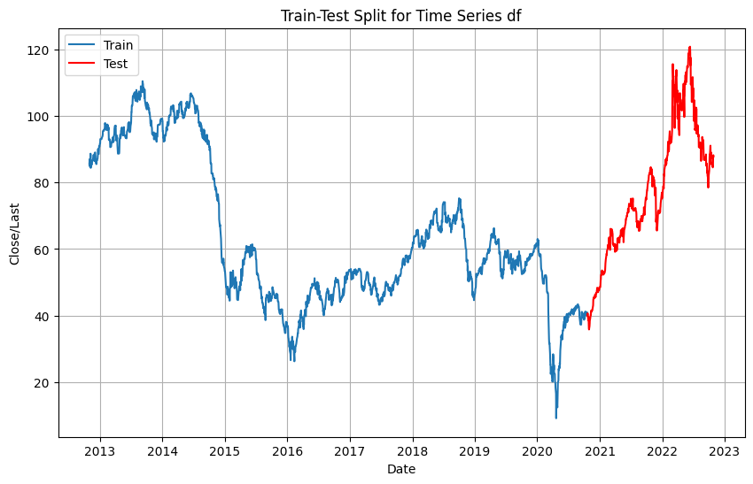
Model Training
The model training process involved splitting the dataset into training and testing sets, with the training set comprising 80% of the data (approximately 2,038 records) and the testing set comprising the remaining 20% (around 510 records). The team then performed hyperparameter tuning to optimize the model's performance, which is showcased through a training curve or screenshot.

Slide 17
Performance Evaluation
Root Mean Squared Error (RMSE) for the evaluated models
7.21
3.67
3.44
3.12
2.95
ARIMA
Exponential Smoothing
Linear Regression
Exponential Regression
Prophet

Slide 18
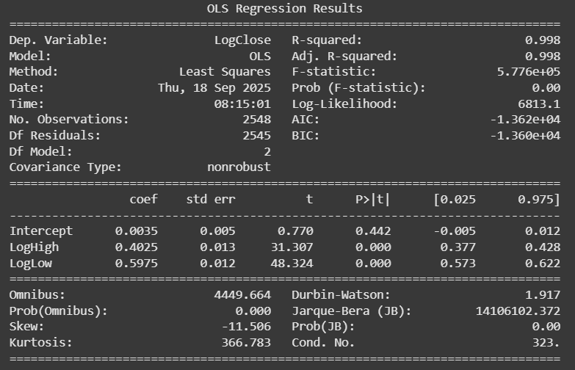
Performance Evaluation
Best model with Root Mean Squared Error (RMSE) of 0.785 was Exponential Model with transformed features.
import numpy as np
import statsmodels.formula.api as smf
from sklearn.metrics import mean_squared_error
# Log-transform predictors to reduce skewness
df2['LogHigh'] = np.log(df2['High'])
df2['LogLow'] = np.log(df2['Low'])
# Log-transform target (Close/Last)
df2['LogClose'] = np.log(df2['Close/Last'])
# --- Exponential Model with transformed features ---
model_exp_trans = smf.ols('LogClose ~ LogHigh + LogLow', data=df2).fit()
# Predict on original scale
pred_exp_trans = np.exp(model_exp_trans.predict(df2))
# Calculate RMSE
rmse_exp_trans = np.sqrt(mean_squared_error(df2['Close/Last'], pred_exp_trans))
# Output results
print("RMSE (Log-transformed High + Low):", rmse_exp_trans)
print(model_exp_trans.summary())
0.78
Exponential Regression Log-transformed High + Low

Slide 19
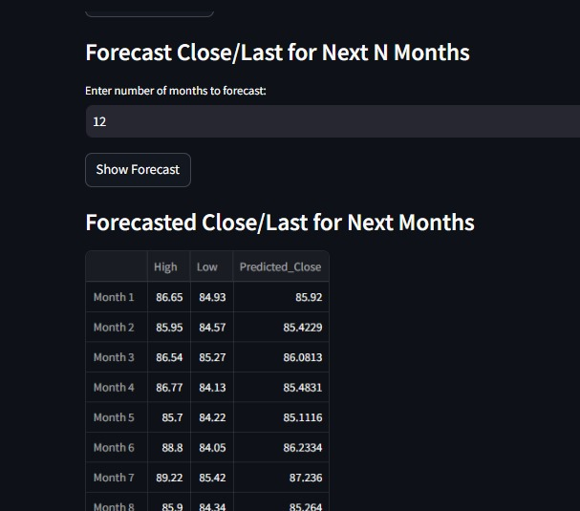
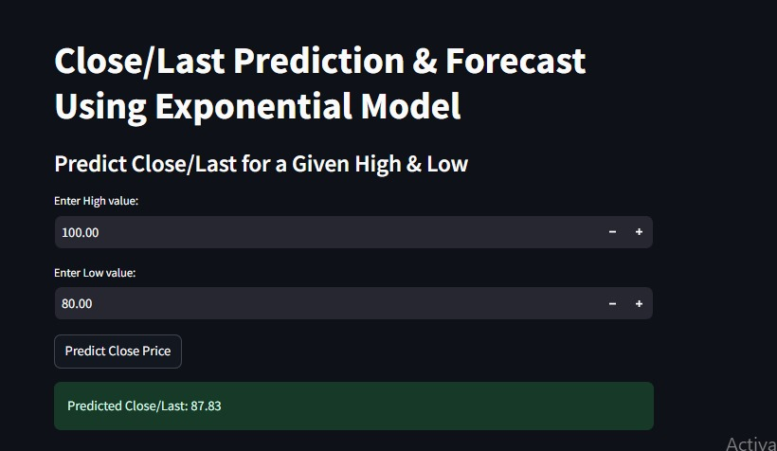
Deployment in Streamlit
The Oil Price Prediction project has delivered a user-friendly Streamlit application that empowers users to interact with the forecasting models. This application enables users to input new data, visualize historical and predicted oil prices, and generate dynamic forecasts to support business decision-making.

Slide 20



Conclusion
Best model achieved
Predictions track actual oil price trends
Business applications
RMSE ≈ 0.7850, R² ≈ 0.98
Hedging, trading, and policymaking
Accurately forecasting price movements
The Oil Price Prediction project has delivered promising results, with the best-performing model achieving high accuracy metrics and effectively tracking the actual oil price trends. These models can be valuable for various business applications, such as hedging, trading, and policymaking.

Slide 21



Future Work
Incorporate Additional Features
Experiment with Deep Learning Techniques
Implement Real-time Deployment with APIs
Explore incorporating macroeconomic indicators, geopolitical events, and weather data that may impact crude oil prices. Use feature engineering techniques to create new, potentially more informative features.
Evaluate the performance of deep learning models, such as recurrent neural networks (RNNs), long short-term memory (LSTMs), and transformer-based models, which have shown promising results in time series forecasting tasks.
Develop a system that can ingest real-time data from various sources, such as commodity exchanges or news feeds, and provide up-to-date price forecasts. Integrate the forecasting models into a web-based or mobile application, exposing the predictions through a user-friendly API.
By addressing these future work directions, the crude oil price prediction system can be further enhanced, providing more accurate and timely forecasts to support decision-making processes in the energy and financial sectors.

Slide 22

Thank You
Thank you all for your time and attention today. We've covered a lot of ground in our presentation on the Oil Price Prediction project. I'm excited to hear your thoughts and answer any questions you may have. Please feel free to ask about the models, the deployment, or any other aspect of the project. I'm here to provide further clarity and address any concerns you may have.

Slide 23

The oil price prediction models developed in this project have demonstrated strong performance, with the best model achieving impressive accuracy metrics. These models can effectively track and forecast crude oil price trends, making them a valuable tool for businesses in hedging, trading, and policymaking decisions. Moving forward, the project aims to further enhance its capabilities by incorporating additional data sources, exploring advanced deep learning techniques, and enabling real-time deployment through APIs, ensuring the continued relevance and applicability of these models in the dynamic oil market.

